Slide 1
Data wrangling and Feature Engineering
Lecture -9
Sumita Narang

Slide 2
Objectives
Data cleaning
Data Integration/ Aggregation
Data Sampling
Handling Numeric Data
Discretization, Binarization
Normalization
Data Smoothening
Dealing with textual Data
Managing Categorical Attributes
Transforming Categorical to Numerical Values
Encoding techniques
Feature Engineering
Feature Extraction (Dimensionality Reduction)
Feature Construction
Feature Subset selection
Filter methods
Wrapper methods
Embedded methods
Feature Learning
Case Study involving FE tasks

Slide 3
Data Cleaning, Data Integration
Source Courtesy: Some of the contents of this PPT are sourced from materials provided by publishers of prescribed books

Slide 4
Data Cleaning
Data in the Real World Is Dirty: Lots of potentially incorrect data, e.g., instrument faulty, human or computer error, transmission error
incomplete: lacking attribute values, lacking certain attributes of interest, or containing only aggregate data
e.g., Occupation = “ ” (missing data)
noisy: containing noise, errors, or outliers
e.g., Salary = “−10” (an error)
inconsistent: containing discrepancies in codes or names, e.g.,
Age = “42”, Birthday = “03/07/2010”
Was rating “1, 2, 3”, now rating “A, B, C”
discrepancy between duplicate records
Intentional (e.g., disguised missing data)
Jan. 1 as everyone’s birthday?

Slide 5
Incomplete (Missing) Data
Data is not always available
E.g., many tuples have no recorded value for several attributes, such as customer income in sales data
Missing data may be due to
equipment malfunction
inconsistent with other recorded data and thus deleted
data not entered due to misunderstanding
certain data may not be considered important at the time of entry
not register history or changes of the data
Missing data may need to be inferred

Slide 6
How to Handle Missing Data?
Ignore the tuple: usually done when class label is missing (when doing classification)—not effective when the % of missing values per attribute varies considerably
Fill in the missing value manually: tedious + infeasible?
Fill in it automatically with
a global constant : e.g., “unknown”, a new class?!
the attribute mean
the attribute mean for all samples belonging to the same class: smarter
the most probable value: inference-based such as Bayesian formula or decision tree

Slide 7
Noisy Data
Noise: random error or variance in a measured variable
Incorrect attribute values may be due to
faulty data collection instruments
data entry problems
data transmission problems
technology limitation
inconsistency in naming convention
7
Notes:
7

Slide 8
How to Handle Noisy Data?
Binning (also used for discretization)
first sort data and partition into (equal-frequency) bins
then one can smooth by bin means, smooth by bin median, smooth by bin boundaries, etc.
Binning methods smooth a sorted data value by consulting its "neighborhood," that is, the values around it, i.e. they perform local smoothing.
Regression
smooth by fitting the data into regression functions
Clustering
detect and remove outliers
Combined computer and human inspection
detect suspicious values and check by human (e.g., deal with possible outliers)
Notes:
Enrich using data integration research!!

Slide 9
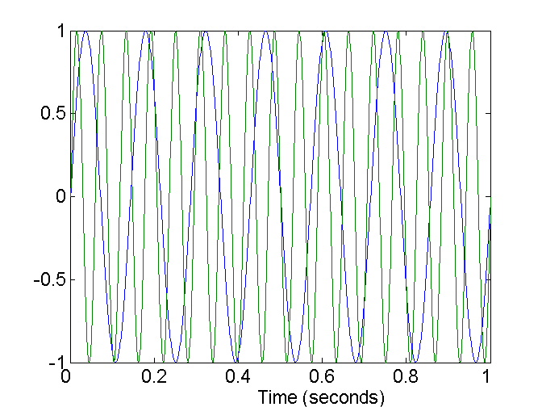
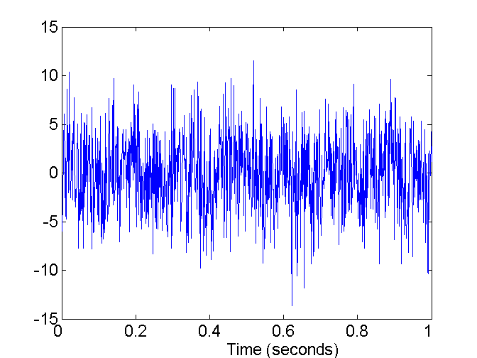
Noise
Noise refers to modification of original values
Examples: distortion of a person’s voice when talking on a poor phone and “snow” on television screen
Two Sine Waves
Two Sine Waves + Noise

Slide 10
Duplicate Data
Data set may include data objects that are duplicates, or almost duplicates of one another
Major issue when merging data from heterogonous sources
Examples:
Same person with multiple email addresses
Data cleaning
Process of dealing with duplicate data issues

Slide 11

Outliers
Outliers are data objects with characteristics that are considerably different than most of the other data objects in the data set

Slide 12
Data Cleaning as a Process
Data discrepancy detection
Use metadata (e.g., domain, range, dependency, distribution)
Check field overloading
Check uniqueness rule, consecutive rule and null rule
Use commercial tools
Data scrubbing: use simple domain knowledge (e.g., postal code, spell-check) to detect errors and make corrections
Data auditing: by analyzing data to discover rules and relationship to detect violators (e.g., correlation and clustering to find outliers)
Data migration and integration
Data migration tools: allow transformations to be specified
ETL (Extraction/Transformation/Loading) tools: allow users to specify transformations through a graphical user interface
Integration of the two processes
Iterative and interactive (e.g., Potter’s Wheels)

Slide 13
Data Integration/ Data Aggregation
Data integration:
Combines data from multiple sources into a coherent store
Schema integration: e.g., A.cust-id ≡ B.cust-#
Integrate metadata from different sources
Entity identification problem:
Identify real world entities from multiple data sources, e.g., Bill Clinton = William Clinton
Detecting and resolving data value conflicts
For the same real world entity, attribute values from different sources are different
Possible reasons: different representations, different scales, e.g., metric vs. British units
13
Notes:
Should ask students to do some survey on data integration. -JH

Slide 14
Handling Redundancy in Data Integration
Redundant data occur often when integration of multiple databases
Object identification: The same attribute or object may have different names in different databases
Derivable data: One attribute may be a “derived” attribute in another table, e.g., annual revenue
Redundant attributes may be able to be detected by correlation analysis and covariance analysis
Careful integration of the data from multiple sources may help reduce/avoid redundancies and inconsistencies and improve mining speed and quality
14

Slide 15
Data Sampling
Source Courtesy: Some of the contents of this PPT are sourced from materials provided by publishers of prescribed books

Slide 16
Central Limit Theorem
The Central Limit Theorem (CLT) is a statistical theory states that given a sufficiently large sample size from a population with a finite level of variance, the mean of all samples from the same population will be approximately equal to the mean of the population.
Larger the sample size, the more would be the normal distribution of means of samples

Slide 17
Important statistical terms
Population:
a set which includes all
measurements of interest
to the researcher
(The collection of all responses, measurements, or counts that
are of interest)
Sample:
A subset of the population

Slide 18
Why sampling?
Get information about large populations
Less costs
Less field time
More accuracy i.e. Can Do A Better Job of Data Collection
When it’s impossible to study the whole population

Slide 19
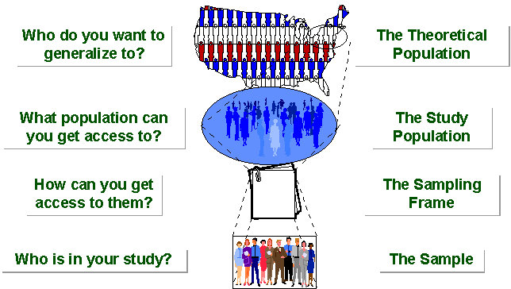
SAMPLING BREAKDOWN
Notes:
Picture of sampling breakdown

Slide 20
Definitions
Target Population:
The population to be studied/ to which the investigator wants to generalize his results
Sampling Unit:
smallest unit from which sample can be selected
Sampling frame
List of all the sampling units from which sample is drawn
Sampling scheme
Method of selecting sampling units from sampling frame

Slide 21
Types of Sampling

Slide 22
Non probability Sampling
Any sampling method where some elements of population have no chance of selection (these are sometimes referred to as 'out of coverage'/'undercovered'), or where the probability of selection can't be accurately determined. It involves the selection of elements based on assumptions regarding the population of interest, which forms the criteria for selection. Hence, because the selection of elements is nonrandom, nonprobability sampling not allows the estimation of sampling errors..
Example: We visit every household in a given street, and interview the first person to answer the door. In any household with more than one occupant, this is a nonprobability sample, because some people are more likely to answer the door (e.g. an unemployed person who spends most of their time at home is more likely to answer than an employed housemate who might be at work when the interviewer calls) and it's not practical to calculate these probabilities.

Slide 23

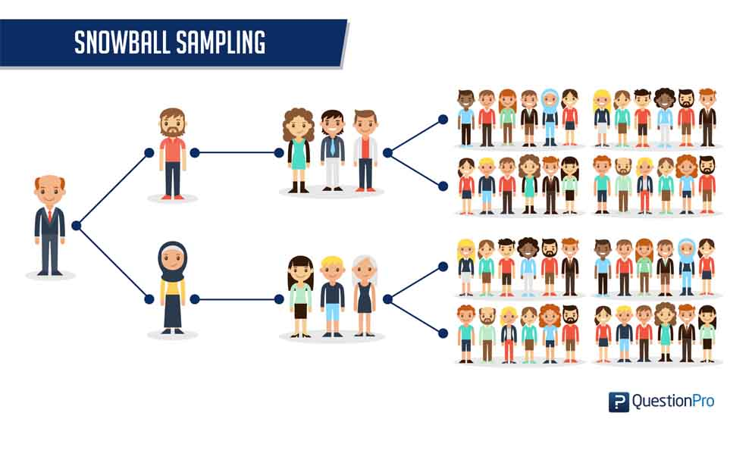
Non probability sampling 1/
Convenience samples (ease of access)
sample is selected from elements of a population that are easily accessible
https://www.questionpro.com/blog/convenience-sampling/
Snowball sampling (friend of friend….etc.)
Also referred as chain sampling, chain-referral sampling, referral samplinghttps://www.statisticshowto.datasciencecentral.com/snowball-sampling/

Slide 24
Non Probability Sampling 2/
Purposive /Judgemental Sampling
A purposive sample is a non-probability sample that is selected based on characteristics of a population and the objective of the study. Purposive sampling is also known as judgmental, selective, or subjective sampling.
The researcher chooses the sample based on who they think would be appropriate for the study. This is used primarily when there is a limited number of people that have expertise in the area being researched. https://www.thoughtco.com/purposive-sampling-3026727
Quota Sampling
The population is first segmented into mutually exclusive sub-groups, just as in stratified sampling.
Then judgment used to select subjects or units from each segment based on a specified proportion. For example, an interviewer may be told to sample 200 females and 300 males between the age of 45 and 60.
It is this second step which makes the technique one of non-probability sampling.
In quota sampling the selection of the sample is non-random. For example interviewers might be tempted to interview those who look most helpful. The problem is that these samples may be biased because not everyone gets a chance of selection. This random element is its greatest weakness and quota versus probability has been a matter of controversy for many years

Slide 25
Probability samples
Random sampling
Each subject has a known probability of being selected
Allows application of statistical sampling theory to results to:
Generalise
Test hypotheses
Ensure
Representativeness
Precision
Definition –
A probability sampling scheme is one in which every unit in the population has a chance (greater than zero) of being selected in the sample, and this probability can be accurately determined.
. When every element in the population does have the same probability of selection, this is known as an 'equal probability of selection' (EPS) design. Such designs are also referred to as 'self-weighting' because all sampled units are given the same weight.

Slide 26
Probability sampling…….
Probability sampling includes:
Simple Random Sampling,
Systematic Sampling,
Stratified Random Sampling,
Cluster Sampling
Multistage Sampling.
Multiphase sampling

Slide 27
Simple random sampling
Applicable when population is small, homogeneous & readily available
All subsets of the frame are given an equal probability. Each element of the frame thus has an equal probability of selection.
It provides for greatest number of possible samples. This is done by assigning a number to each unit in the sampling frame.
A table of random number or lottery system is used to determine which units are to be selected.
Pros –
Estimates are easy to calculate.
Simple random sampling is always an EPS design, but not all EPS designs are simple random sampling.
Cons -
If sampling frame large, this method impracticable.
Minority subgroups of interest in population may not be present in sample in sufficient numbers for study
When the population consists of different types of objects, with widely different numbers of objects, simple random sampling can fail to adequately represent those types of objects that are less frequent.

Slide 28
Variations of Simple Random Sampling
There are two variations on random sampling (and other sampling techniques as well):
(1) sampling without replacement-
as each item is selected, it is removed from the set of all objects that together constitute the population, and
(2) sampling with replacement-
objects are not removed from the population as they are selected for the sample
In sampling with replacement, the same object can be picked more than once.
Note- The samples produced by the two methods are not much different when samples are relatively small compared to the data set size, but sampling with replacement is simpler to analyze since the probability of selecting any object remains constant during the sampling process.

Slide 29
Weighted Random Sampling
https://utopia.duth.gr/~pefraimi/research/data/2007EncOfAlg.pdf
If all items have the same probability to be selected, the problem is known as uniform RS. Uniform random sampling in one pass.
In weighted random sampling (WRS) the items are weighted and the probability of each item to be selected is determined by its relative weight. WRS can be defined with the following algorithm D:

Slide 30
SYSTEMATIC SAMPLING
Systematic sampling relies on arranging the target population according to some ordering scheme and then selecting elements at regular intervals through that ordered list.
Systematic sampling involves a random start and then proceeds with the selection of every kth element from then onwards. In this case, k=(population size/sample size).
It is important that the starting point is not automatically the first in the list, but is instead randomly chosen from within the first to the kth element in the list.
A simple example would be to select every 10th name from the telephone directory (an 'every 10th' sample, also referred to as 'sampling with a skip of 10').

Slide 31
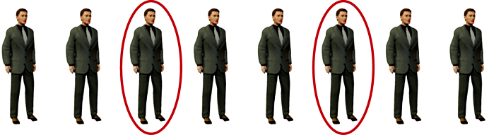
SYSTEMATIC SAMPLING……
As described above, systematic sampling is an EPS method, because all elements have the same probability of selection (in the example given, one in ten). It is not 'simple random sampling' because different subsets of the same size have different selection probabilities - e.g. the set {4,14,24,...,994} has a one-in-ten probability of selection, but the set {4,13,24,34,...} has zero probability of selection.

Slide 32
SYSTEMATIC SAMPLING……
ADVANTAGES:
Sample easy to select
Suitable sampling frame can be identified easily
Sample evenly spread over entire reference population
DISADVANTAGES:
Sample may be biased if hidden periodicity in population coincides with that of selection.
Difficult to assess precision of estimate from one survey.

Slide 33
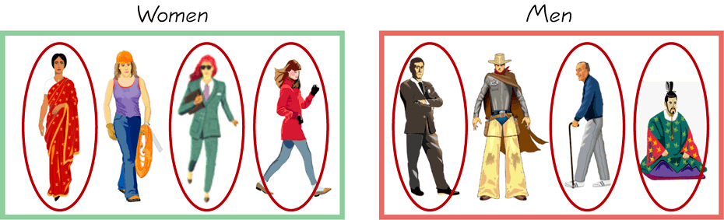
STRATIFIED SAMPLING
Draw a sample from each stratum

Slide 34
Stratified Sampling ….
When the population consists of different types of objects, with widely different numbers of objects, simple random sampling can fail to adequately represent those types of objects that are less frequent. This can cause problems when the analysis requires proper representation of all object types. For example, when building classification models for rare classes, it is critical that the rare classes be adequately represented in the sample. Hence, a sampling scheme that can accommodate differing frequencies for the items of interest is needed.
Stratified sampling, which starts with pre-specified groups of objects, is such an approach. In the simplest version, equal numbers of objects are drawn from each group even though the groups are of different sizes. In another variation, the number of objects drawn from each group is proportional to the size of that group.
Where population embraces a number of distinct categories, the frame can be organized into separate "strata." Each stratum is then sampled as an independent sub-population, out of which individual elements can be randomly selected.
Every unit in a stratum has same chance of being selected.
Using same sampling fraction for all strata ensures proportionate representation in the sample.
Adequate representation of minority subgroups of interest can be ensured by stratification & varying sampling fraction between strata as required.
Finally, since each stratum is treated as an independent population, different sampling approaches can be applied to different strata.

Slide 35
Stratified Sampling ….
Drawbacks to using stratified sampling.
First, sampling frame of entire population has to be prepared separately for each stratum
Second, when examining multiple criteria, stratifying variables may be related to some, but not to others, further complicating the design, and potentially reducing the utility of the strata.
Finally, in some cases (such as designs with a large number of strata, or those with a specified minimum sample size per group), stratified sampling can potentially require a larger sample than would other methods

Slide 36
CLUSTER SAMPLING
Cluster sampling is an example of 'two-stage sampling' .
First stage a sample of areas is chosen;
Second stage a sample of respondents within those areas is selected.
Population divided into clusters of homogeneous units, usually based on geographical contiguity.
Sampling units are groups rather than individuals.
A sample of such clusters is then selected.
All units from the selected clusters are studied.

Slide 37
CLUSTER SAMPLING ….
Advantages :
Cuts down on the cost of preparing a sampling frame.
This can reduce travel and other administrative costs.
Disadvantages:
sampling error is higher for a simple random sample of same size.
Often used to evaluate vaccination coverage in EPI
Identification of clusters
List all cities, towns, villages & wards of cities with their population falling in target area under study.
Calculate cumulative population & divide by 30, this gives sampling interval.
Select a random no. less than or equal to sampling interval having same no. of digits. This forms 1st cluster.
Random no.+ sampling interval = population of 2nd cluster.
Second cluster + sampling interval = 4th cluster.
Last or 30th cluster = 29th cluster + sampling interval

Slide 38
CLUSTER SAMPLING…….
Two types of cluster sampling methods.
One-stage sampling. All of the elements within selected clusters are included in the sample.
Two-stage sampling. A subset of elements within selected clusters are randomly selected for inclusion in the sample.

Slide 39
Cluster sampling
Section 1
Section 2
Section 3
Section 5
Section 4

Slide 40
CLUSTER SAMPLING…….
Freq c f cluster
I 2000 2000 1
II 3000 5000 2
III 1500 6500
IV 4000 10500 3
V 5000 15500 4, 5
VI 2500 18000 6
VII 2000 20000 7
VIII 3000 23000 8
IX 3500 26500 9
X 4500 31000 10
XI 4000 35000 11, 12
XII 4000 39000 13
XIII 3500 44000 14,15
XIV 2000 46000
XV 3000 49000 16
XVI 3500 52500 17
XVII 4000 56500 18,19
XVIII 4500 61000 20
XIX 4000 65000 21,22
XX 4000 69000 23
XXI 2000 71000 24
XXII 2000 73000
XXIII 3000 76000 25
XXIV 3000 79000 26
XXV 5000 84000 27,28
XXVI 2000 86000 29
XXVII 1000 87000
XXVIII 1000 88000
XXIX 1000 89000 30
XXX 1000 90000
90000/30 = 3000 sampling interval

Slide 41
Difference Between Strata and Clusters
Although strata and clusters are both non-overlapping subsets of the population, they differ in several ways.
All strata are represented in the sample; but only a subset of clusters are in the sample.
With stratified sampling, the best survey results occur when elements within strata are internally homogeneous. However, with cluster sampling, the best results occur when elements within clusters are internally heterogeneous

Slide 42
MULTISTAGE SAMPLING
Complex form of cluster sampling in which two or more levels of units are embedded one in the other.
First stage, random number of districts chosen in all states.
Followed by random number of talukas, villages.
Then third stage units will be houses.
All ultimate units (houses, for instance) selected at last step are surveyed.
This technique, is essentially the process of taking random samples of preceding random samples.
Not as effective as true random sampling, but probably solves more of the problems inherent to random sampling.
An effective strategy because it banks on multiple randomizations. As such, extremely useful.
Multistage sampling used frequently when a complete list of all members of the population not exists and is inappropriate.
Moreover, by avoiding the use of all sample units in all selected clusters, multistage sampling avoids the large, and perhaps unnecessary, costs associated with traditional cluster sampling.

Slide 43
MULTI PHASE SAMPLING
Part of the information collected from whole sample & part from subsample.
In Tb survey MT in all cases – Phase I
X –Ray chest in MT +ve cases – Phase II
Sputum examination in X – Ray +ve cases - Phase III
Survey by such procedure is less costly, less laborious & more purposeful

Slide 44
Errors in sample
Systematic error (or bias)
Inaccurate response (information bias)
Selection bias
Sampling error (random error)
Type of Errors
Type 1 Error
Type 2 Error
TYPE 1 Errors
The probability of finding a difference with our sample compared to population, and there really isn’t one….
Known as the α (or “type 1 error”)
Usually set at 5% (or 0.05)
TYPE 2 Errors
The probability of not finding a difference that actually exists between our sample compared to the population…
Known as the β (or “type 2 error”)
Power is (1- β) and is usually 80%

Slide 45
How to find Sample Size
https://www.statisticshowto.datasciencecentral.com/probability-and-statistics/find-sample-size/
https://www.statisticshowto.datasciencecentral.com/tables/z-table/

Slide 46
Sampling Techniques Comparison

Slide 47
Handling Numerical Data
Source Courtesy: Some of the contents of this PPT are sourced from materials provided by publishers of prescribed books

Slide 48
Learning Objectives
Articulate the need for feature scaling
List and define various data transformation methods
Make the calculations that are necessary to get meaningful transformations

Slide 49
Four Levels of data
Used for names or label a series of values.
Ex: Gender(dichotomous),Hair color, Country names
Ordinal values represent discrete and ordered units.
Ex: Shirt size, letter grades, food quality
Nominal
Categorical
(qualitative)
Ordinal
Data
Interval values represent ordered units that have the same difference.
Ex: temperature of a given place
Ratio values represent ordered units that have the same difference. There’s a value that means “nothing/none.”
Ex: Age, weight, test score
Interval
Numerical
(quantitative)
Ratio

Slide 50
Flavors for Quantitative Attributes
Quantitative Attributes
Discrete
Continuous
Has a finite or countably infinite set of values
Often integer values are used to denote the values
Ex: No of employees, set of words in a document collection
Has real numbers as attribute values
Often real numbers are used to denote the values
Ex: height, Weight, Blood sugar levels
Notes:
Discrete or whole numbers
Continuous or fractional numbers

Slide 51
Linear Models
Y = W₀+W₁ X
W indicates the change in Y per unit change of X
If X changes scale, W will change its value
Regression coefficients depend on the magnitude of the variable
Features with bigger magnitude dominate over the features with smaller magnitudes
Euclidian distances are sensitive to feature magnitude
Hence it is a good practice to have all variables within a similar scale.
Notes:
If X is a distance variable and in kilometers and we change it into miles
Gradient descent converges faster when all the variables are in the similar scale
Feature scaling helps decrease the time of finding support vectors
Euclidian distances are sensitive to feature magnitude
For distance-based methods, normalization helps prevent attributes with initially large ranges (e.g., income) from out-weighing attributes with initially smaller ranges (e.g., binary attributes).

Slide 52
Algorithms that are sensitive to feature magnitude
Linear and Logistic Regression
Neural Networks
Support Vector Machines
KNN
K-Means Clustering
Linear Discriminant Analysis (LDA)
Principal Component Analysis (PCA)

Slide 53
Data Transformation
Data transformation tasks:
Binarization
Normalization
Discretization
Aggregation
Attribute construction
Attribute Subset Selection

Slide 54
Issues with Continuous Predictors 1/
Predictors that are on a continuous scale are subject to a host of potential issues
For example, models that construct relationships between the predictors and the response; are based on the rank of the predictors’ values rather than the actual value, e.g. trees are immune to predictor distributions that are skewed or to individual samples that have unusual values (i.e., outliers).
Other models such as K-nearest neighbors and support vector machines are much more sensitive to predictors with skewed distributions or outliers.
Continuous predictors that are highly correlated with each other is another regularly occurring scenario that presents a problem for some models but not for others.
Partial least squares, for instance, is specifically built to directly handle highly correlated predictors.
But models like multiple linear regression or neural networks are adversely affected in this situation.

Slide 55
Issues with Continuous Predictors 2/
Illustrate how to handle continuous predictors with commonly occurring issues. The predictors may:
be on vastly different scales.
follow a skewed distribution where a small proportion of samples are orders of magnitude larger than the majority of the data (i.e., skewness).
contain a small number of extreme values.
be censored on the low and/or high end of the range. have a complex relationship with the response and is truly predictive but cannot be adequately represented with a simple function or extracted by sophisticated models.
contain relevant and overly redundant information. That is, the information collected could be more effectively and efficiently represented with a smaller, consolidated number of new predictors while still preserving or enhancing the new predictors’ relationship with the response.

Slide 56

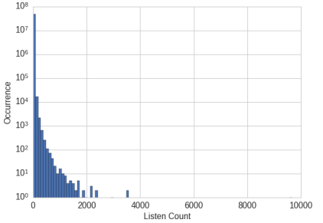
Motivation for Binarization
Echo Nest Taste Profile Dataset:
There are more than 48 million triplets of user ID, song ID, and listen count.
The full dataset contains 1,019,318 unique users and 384,546 unique songs.
Build a recommender system to recommend songs to users.
Larger count means the user really likes the song ?
99% of the listen counts are 24 or lower
Raw listen count is not a robust measure of user taste.
Notes:
One feature of the recommender might predict how much a user will enjoy a particular song. Since the data contains actual listen counts, should that be the target of the prediction?
This would be the right thing to do if a large listen count means the user really likes the song and a low listen count means they’re not interested in it. How‐ ever, the data shows that while 99% of the listen counts are 24 or lower, there are also some listen counts in the thousands, with the maximum being 9,667.
A more robust representation of user preference is to binarize the count and clip all counts greater than 1 to 1. In other words, if the user listened to a song at least once, then we count it as the user liking the song. This way, the model will not need to spend cycles on predicting the minute differences between the raw counts. The binary target is a simple and robust measure of user preference.

Slide 57
Binarization
Binarization maps a continuous or categorical attribute into one or more binary variables.
Must maintain ordinal relationship
Assume an ordinal attribute for representing service of a restaurant: ({Awful,Poor,OK,Good,Great})
Service quality | Integer Value | X1 | X2 | X3
Awful | 0 | 0 | 0 | 0
Poor | 1 | 0 | 0 | 1
Ok | 2 | 0 | 1 | 0
Good | 3 | 0 | 1 | 1
Great | 4 | 1 | 0 | 0
Unintended relationships: X2 and X3 are now correlated because “good” is encoded using both attributes

Slide 58
Binarization
Service quality | Integer Value | X1 | X2 | X3 | X4 | X5
Awful | 0 | 1 | 0 | 0 | 0 | 0
Poor | 1 | 0 | 1 | 0 | 0 | 0
Ok | 2 | 0 | 0 | 1 | 0 | 0
Good | 3 | 0 | 0 | 0 | 1 | 0
Great | 4 | 0 | 0 | 0 | 0 | 1
Binary attributes, where only the presence of 1 is important
One binary attribute for each categorical value
Be Careful: Number of resulting attributes may become too large

Slide 59
Normalization
Types of common scaling operations or Normalization methods
Min-max normalization
z-score normalization
Normalization by decimal scaling

Slide 60
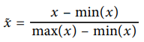
Min-Max Scaling
Min-max scaling squeezes (or stretches) all feature values to be within the range of [0, 1].
x
x - feature value
min(x) - minimum value of feature x
max(x) - maximum value of feature x
0
1

Slide 61
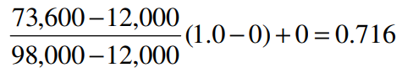
Example: Min-max Normalization
Let income range $12,000 to $98,000 be normalized to [0.0, 1.0].
Then $73,000 is mapped to ?

Slide 62
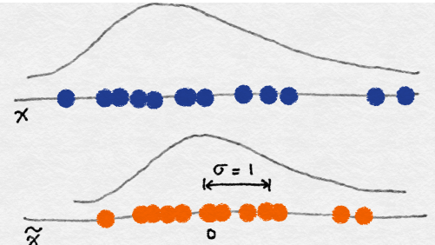
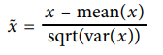
z-score Normalization -> Standardization
In z-score normalization (or zero-mean normalization)
The values for an attribute, x, are normalized based on the mean (x) and standard deviation (σ_{x} ) of x.
The resulting scaled feature has a mean of 0 and a variance of 1.

Slide 63
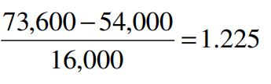
Example: z-score Normalization
Let μ_{x}= 54,000, σ_{x} = 16,000, for the attribute income
With z-score normalization, a value of $73,600 for income is transformed to:
Z=score normalization can change the original data quite a bit.

Slide 64
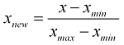
Normalization
https://www.statisticshowto.datasciencecentral.com/normalized/
The word “normalization” is used informally in statistics, and so the term normalized data can have multiple meanings. In most cases, when you normalize data you eliminate the units of measurement for data, enabling you to more easily compare data from different places. Some of the more common ways to normalize data include:
• Transforming data using a z-score or t-score. This is usually called standardization. In the vast majority of cases, if a statistics textbook is talking about normalizing data, then this is the definition of “normalization” they are probably using.
• Rescaling data to have values between 0 and 1. This is usually called feature scaling. One possible formula to achieve this is:
• Standardizing residuals: Ratios used in regression analysis can force residuals into the shape of a normal distribution.
• Normalizing Moments using the formula μ/σ.
• Normalizing vectors (in linear algebra) to a norm of one. Normalization in this sense means to transform a vector so that it has a length of one.

Slide 65
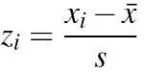
Standardization
The terms normalization and standardization are sometimes used interchangeably, but they usually refer to different things. Normalization usually means to scale a variable to have a values between 0 and 1, while standardization transforms data to have a mean of zero and a standard deviation of 1. This standardization is called a z-score, and data points can be standardized with the following formula:
A z-score standardizes variables.
Where:
• xi is a data point (x1, x2…xn).
• x̄ is the sample mean.
• s is the sample standard deviation.
Z-scores are very common in statistics. They allow you to compare different sets of data and to find probabilities for sets of data using standardized tables (called z-tables). For more about z-scores, see: Z-score: Definition, Formula, and Calculation.

Slide 66
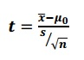
T-Score
https://www.statisticshowto.datasciencecentral.com/probability-and-statistics/t-distribution/t-score-formula/
A t-score is one form of a standardized test statistic (the other you’ll come across in elementary statistics is the z-score). The t score formula enables you to take an individual score and transform it into a standardized form > one which helps you to compare scores.
You’ll want to use the t score formula when you don’t know the population standard deviation and you have a small sample (under 30).
The t score formula is:
Where
x̄ = sample mean
μ0 = population mean
s = sample standard deviation
n = sample size

Slide 67
Decimal Scaling
Normalizes by moving the decimal point of values of attribute A.
The number of decimal points moved depends on the maximum absolute value of A.
A value, v, of A is normalized to v′ by computing
where j is the smallest integer such that Max(|v′|) < 1.
V’=$\frac{V}{10J}$

Slide 68
Examples of Decimal Scaling
Example-1
CGPA | Formula | Normalized CGPA
2 | 2/10 | 0.2
3 | 3/10 | 0.3
Example-2
Bonus | Formula | Normalized Bonus
400 | 4/1000 | 0.4
310 | 3/1000 | 0.31
Example-3
Salary | Formula | Normalized Salary
40000 | 4/100000 | 0.4
31000 | 3/100000 | 0.31

Slide 69
Aggregation
Combining two or more attributes (or objects) into a single attribute (or object)
Purpose
Data reduction
Change of scale
More stable data

Slide 70
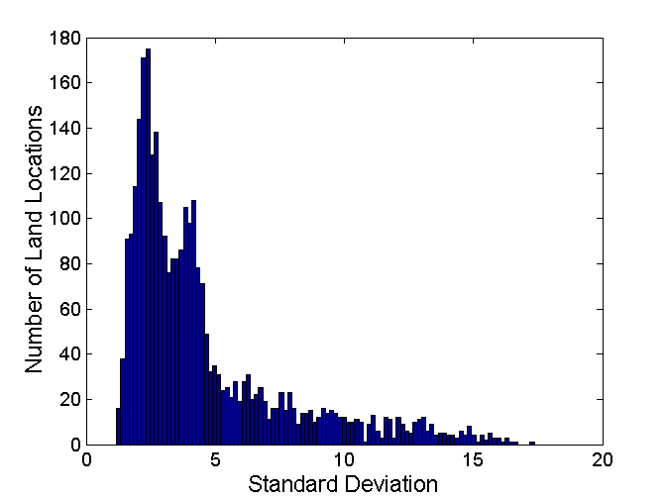
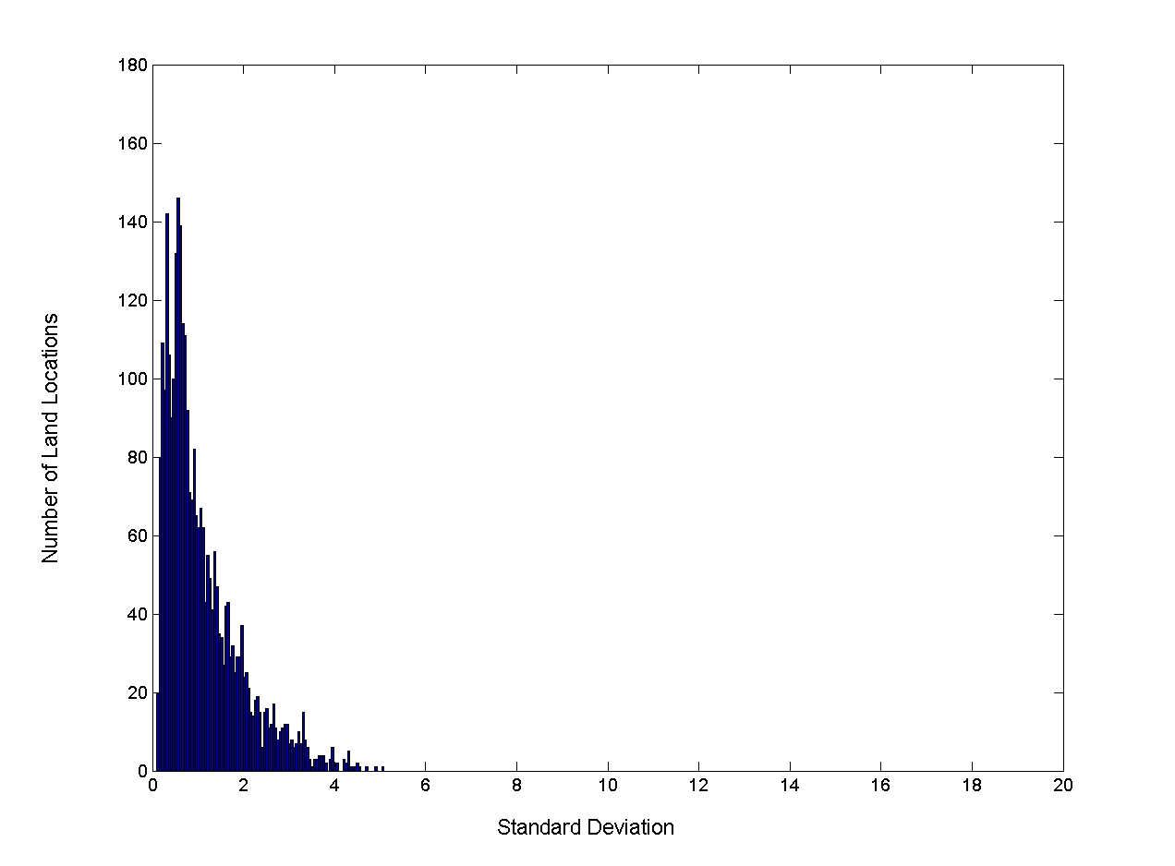
Aggregation – Change in Variability
Less variability at “higher-level” view
Standard Deviation of Average Monthly Precipitation
Standard Deviation of Average Yearly Precipitation

Slide 71
Correlation Analysis (Nominal Data)
Χ² (chi-square) test
The larger the Χ² value, the more likely the variables are related
The cells that contribute the most to the Χ² value are those whose actual count is very different from the expected count
Correlation does not imply causality
# of hospitals and # of car-theft in a city are correlated
Both are causally linked to the third variable: population
https://www.khanacademy.org/math/statistics-probability/inference-categorical-data-chi-square-tests/chi-square-goodness-of-fit-tests/v/pearson-s-chi-square-test-goodness-of-fit

Slide 72
Chi-Square Calculation: An Example
 | Play chess | Not play chess | Sum (row)
Like science fiction | 250(90) | 200(360) | 450
Not like science fiction | 50(210) | 1000(840) | 1050
Sum(col.) | 300 | 1200 | 1500
Χ² (chi-square) calculation (numbers in parenthesis are expected counts calculated based on the data distribution in the two categories)
It shows that like_science_fiction and play_chess are correlated in the group

Slide 73
Correlation Analysis (Numeric Data)
Correlation coefficient (also called Pearson’s product moment coefficient)
where n is the number of tuples, and are the respective means of A and B, σ_{A} and σ_{B} are the respective standard deviation of A and B, and Σ(a_{i}b_{i}) is the sum of the AB cross-product.
If r_{A,B} > 0, A and B are positively correlated (A’s values increase as B’s). The higher, the stronger correlation.
r_{A,B} = 0: independent; r_{AB} < 0: negatively correlated

Slide 74
Correlation (viewed as linear relationship)
Correlation measures the linear relationship between objects
To compute correlation, we standardize data objects, A and B, and then take their dot product

Slide 75
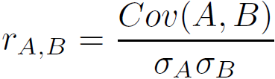
Covariance (Numeric Data)
Covariance is similar to correlation
where n is the number of tuples, and are the respective mean or expected values of A and B, σ_{A} and σ_{B} are the respective standard deviation of A and B
Positive covariance: If Cov_{A,B} > 0, then A and B both tend to be larger than their expected values
Negative covariance: If Cov_{A,B} < 0 then if A is larger than its expected value, B is likely to be smaller than its expected value
Independence: Cov_{A,B} = 0
Correlation coefficient:

Slide 76
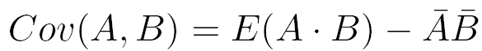
Co-Variance: An Example
It can be simplified in computation as
Suppose two stocks A and B have the following values in one week: (2, 5), (3, 8), (5, 10), (4, 11), (6, 14).
Question: If the stocks are affected by the same industry trends, will their prices rise or fall together?
E(A) = (2 + 3 + 5 + 4 + 6)/ 5 = 20/5 = 4
E(B) = (5 + 8 + 10 + 11 + 14) /5 = 48/5 = 9.6
Cov(A,B) = (2×5+3×8+5×10+4×11+6×14)/5 − 4 × 9.6 = 4
Thus, A and B rise together since Cov(A, B) > 0.

Slide 77
Discretization
Three types of attributes
Nominal—values from an unordered set, e.g., color, profession
Ordinal—values from an ordered set, e.g., military or academic rank
Numeric—real numbers, e.g., integer or real numbers
Discretization: Divide the range of a continuous attribute into intervals
Interval labels can then be used to replace actual data values
Reduce data size by discretization
Supervised vs. unsupervised
Split (top-down) vs. merge (bottom-up)
Discretization can be performed recursively on an attribute
Prepare for further analysis, e.g., classification
Notes:
08.09.12 MK: Slide moved here from Ch. 3. Added examples.

Slide 78
Data Discretization Methods
Typical methods: All the methods can be applied recursively
Binning
Top-down split, unsupervised
Histogram analysis
Top-down split, unsupervised
Clustering analysis (unsupervised, top-down split or bottom-up merge)
Decision-tree analysis (supervised, top-down split)
Correlation (e.g., χ²) analysis (unsupervised, bottom-up merge)
78
Notes:
78

Slide 79
Simple Discretization: Binning
Equal-width (distance) partitioning
Divides the range into N intervals of equal size: uniform grid
if A and B are the lowest and highest values of the attribute, the width of intervals will be: W = (B –A)/N.
The most straightforward, but outliers may dominate presentation
Skewed data is not handled well
Equal-depth (frequency) partitioning
Divides the range into N intervals, each containing approximately same number of samples
Good data scaling
Managing categorical attributes can be tricky

Slide 80
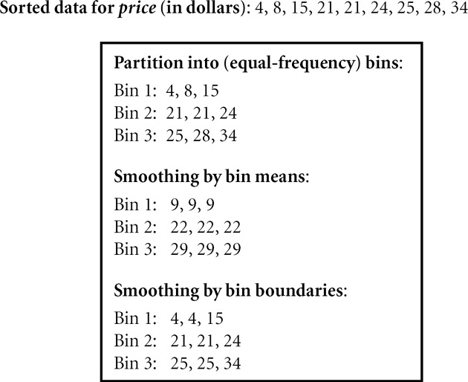
Binning Methods for Data Smoothing

Slide 81
Discretization by Classification & Correlation Analysis
Classification (e.g., decision tree analysis)
Supervised: Given class labels, e.g., cancerous vs. benign
Using entropy to determine split point (discretization point)
Top-down, recursive split
Details to be covered in Chapter “Classification”
Correlation analysis (e.g., Chi-merge: χ²-based discretization)
Supervised: use class information
Bottom-up merge: find the best neighboring intervals (those having similar distributions of classes, i.e., low χ² values) to merge
Merge performed recursively, until a predefined stopping condition
81
Notes:
81

Slide 82
Discretization
Convert continuous attribute into a discrete one
Age | Alzimer
60 | Yes
65 | Yes
45 | No
55 | Yes
50 | No
C1
C2
30
40
50
60
70
80
90
How to choose the number of intervals K ?
How to define the cut points ?
… which are relevant according to the studied problem….
Main issues
Notes:
Some statistical methods or machine learning algorithms like decision trees can handle discrete attributes only.

Slide 83
Discretization
Unsupervised discretization
Equal-interval binning
Equal-frequency binning
Supervised discretization
Entropy-based discretization
It tries to maximize the “purity” of the intervals (i.e. to contain as less as possible mixture of class labels)
• Class labels are ignored
• The best number of bins k is determined experimentally
Notes:
With or without taking class information (Supervised / Unsupervised)
Number of variables used (static variable / dynamic variable)

Slide 84
Unsupervised Discretization
User specifies the number of intervals and/or how many data points should be included in any given interval.
The following heuristic is often used to choose intervals:
The number of intervals for each attribute should not be smaller than the number of classes (if known).
The other popular heuristic is to choose the number of intervals, n_{Fi}, for each attribute, F_{i} (i=1,…,n,) where n is the number of attributes), as follows:
n_{Fi} = M/3∗ C where M is the number of training examples and C is the number of known classes.

Slide 85
Methods for Binning Numeric Predictor Variables
Equal width binning
Equal frequency binning
Binning by clustering
Original data: | 53 56 57 63 66 67 67 67 68 69 70 70 70 70 72 73 75 75 76 76 78 79 80 81
Method |  | Bin1 | Bin2 | Bin3
Equi Width | 81-53=28 28/3=9.33 | [53,62)= {53,56,57} | [62,72)= {63,66,67,67,67,68,69,70,70,70} | [72,81]={72,73,75,75,76,76,78,79,80,81}
Equi Frequency | 24/3=8 | {53,56,57,63,66,67, 67,67} | {68,69,70,70,70, 72,73,75} | {75,76,76,78,79,80,81}
Find natural gaps in the data | some variation | {53,56,57,63,66,67, 67,67,68,69} | {70,70,70, 72,73,75,75} | {76,76,78,79,80,81}
Notes:
Equal width binning : Can be greatly affected by outliers

Slide 86
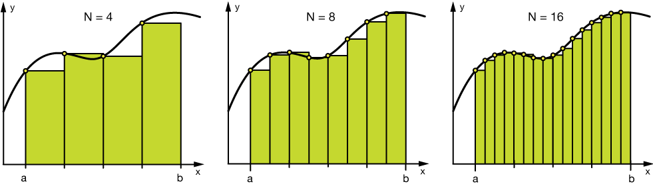
Binning
Binning can be applied on both categorical and numerical data:
#Numerical Binning Example
Value Bin 0-30 -> Low 31-70 -> Mid 71-100 -> High
#Categorical Binning Example
Value Bin Spain -> Europe Italy -> Europe Chile -> South America Brazil -> South America
The main motivation of binning is to make the model more robust and prevent overfitting, however, it has a cost to the performance. Every time you bin something, you sacrifice information and make your data more regularized.

Slide 87
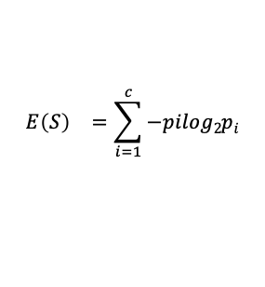
Supervised Discretization - Entropy
Entropy E(S) - measure of the impurity/un-certanity in a group of examples
S - training set with C₁,...,C_{C} classes
p_{i} - proportion of C_{c} in S
$${E\left(S\right)}^{}=\sum_{i=1}^{c}{−pilog2pi}$$
Very impure group
Less impure group
Pure group

Slide 88
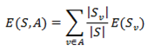
Supervised Discretization - Information Gain
Information gain (IG) measures how much “information” a feature gives us about the class.
Features that perfectly partition should give maximal information.
Unrelated features should give no information.
It measures the reduction in entropy.
Where S is the number of samples in the training set, with S_{v} instances belonging to class i, where i = 1, … , c.

Slide 89
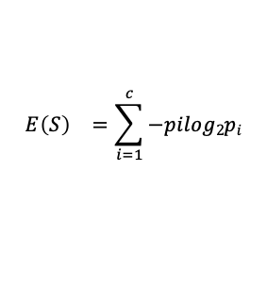
Supervised Discretization - Entropy Based
Entropy Based Discretization
Sort examples in increasing order
Each value forms an interval (m intervals)
Calculate the entropy measure of this discretization
Calculate "Entropy" for the target given a bin.
Calculate "Information Gain" given a bin. E(S) - E(S,A)
Apply the process recursively until some stopping criterion is met.
E(S) - E(S,A) > δ
$${E\left(S\right)}^{}=\sum_{i=1}^{c}{−pilog2pi}$$

Slide 90
Supervised Discretization Example
Runs | 53 | 56 | 57 | 63 | 66 | 67 | 67 | 67 | 68 | 69 | 70 | 70 | 70 | 70 | 72 | 73 | 75 | 75 | 76 | 76 | 78 | 79 | 80 | 81
Matches Won | Y | Y | Y | N | N | N | N | N | N | N | N | Y | Y | Y | N | N | N | Y | N | N | N | N | N | N
In this example we are discretizing the feature Runs using 2 bins <=60 and >60.
Step 3: Calculate "Entropy" for the target.
Step 4: Calculate "Entropy" for the target given a bin.
Runs
Y | N
7 | 17
 |  | Matches Won
 |  | Y | N
Runs | <= 60 | 3 | 0
 | > 60 | 4 | 17
E (Runs) = E(7, 17) = E(0.29, .71)
= -0.29 x log₂(0.29) - 0.71 x log₂(0.71)
= 0.871
E (Matches Won,Runs) = P(<=60) x E(3,0) + P(>60) x E(4,17)
= 3/24 x 0 + 21/24 x 0.7= 0.615
Step 5: Calculate "Information Gain" given a bin.
Information Gain (Matches Won,Runs) = 0.256

Slide 91
Supervised Discretization Example (Contd..)
Runs | 53 | 56 | 57 | 63 | 66 | 67 | 67 | 67 | 68 | 69 | 70 | 70 | 70 | 70 | 72 | 73 | 75 | 75 | 76 | 76 | 78 | 79 | 80 | 81
Matches Won | Y | Y | Y | N | N | N | N | N | N | N | N | Y | Y | Y | N | N | N | Y | N | N | N | N | N | N
 |  | Matches Won
 |  | Y | N
Runs | <= 60 | 3 | 0
 | > 60 | 4 | 17
 |  | Matches Won
 |  | Y | N
Runs | <= 70 | 6 | 8
 | > 70 | 1 | 9
 |  | Matches Won
 |  | Y | N
Runs | <= 75 | 7 | 11
 | > 75 | 0 | 6
Dealing with Categorical Data
Information Gain = 0.256
Information Gain = 0.101
Information Gain = 0.148

